Slide 1

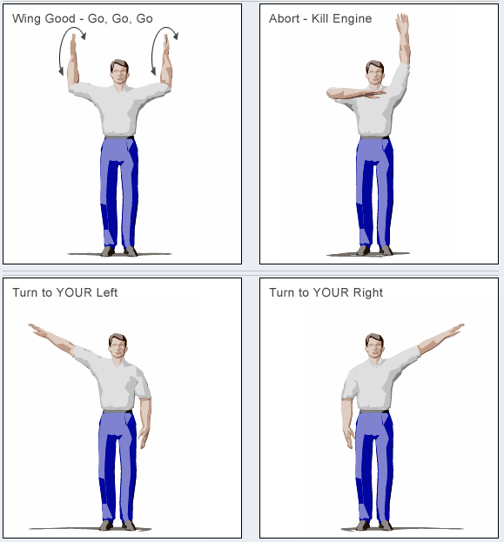
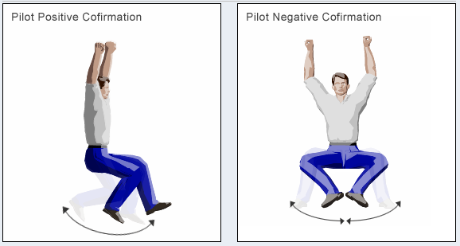
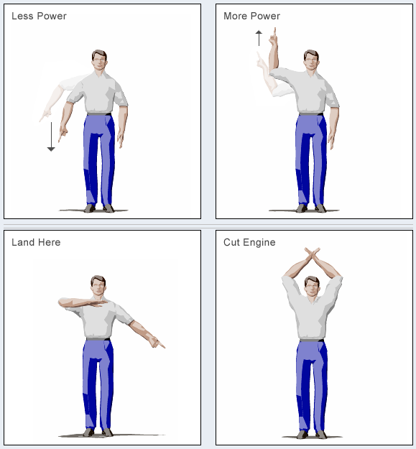
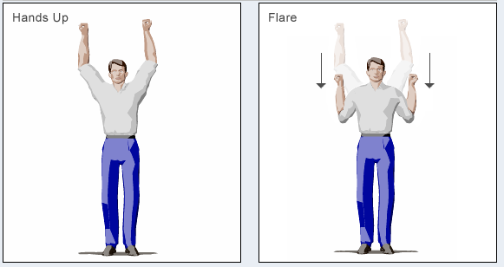
Powered Paragliding Hand Signals
YES
NO
http://www.usppa.org/schools-training/initial-training-for-new-paramotor-pilots/hand-signals-for-ppg/

