Slide 1
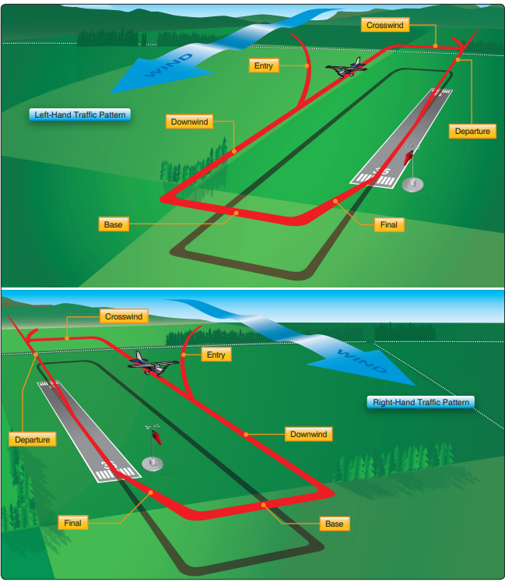
Airport Traffic Patterns
1000’ AGL Typical
Normal Pattern (Left)
Airplane Flying Handbook (FAA-H-8083-3B) Chapter 7
Situational awareness
  Know the active runways
  Familiarize yourself with the pattern legs
  Stay below pattern altitude when landing
  AVOID final/base legs, and extended final approach path
  Communicate & monitor CTAF

